Slide 1
Different types of data analytics
By
Vaibhav P. Vasani
Notes:
https://www.simplilearn.com/what-is-descriptive-analytics-article

Slide 2
Different types of data analytics:
Descriptive analytics,
Diagnostics Analytics,
Predictive analytics,
Prescriptive analytics

Slide 3
Descriptive analytics. What happened?
Diagnostic analytics. Why did this happen?
Predictive analytics. Based on past data, what could happen?
Prescriptive analytics. Taking the other three analytics together as an aggregate, what can we do about it?

Slide 4
What Does Descriptive Analytics Tell Us?
It gives businesses essential information about how it’s doing, where it’s going, and how it’s stacking up against the competition.
The company’s current performance: Descriptive analytics helps businesses keep track of critical metrics involving individuals, groups and teams, and the company as a whole.
For instance, descriptive analytics can show how a specific sales rep is doing this quarter or which of the rep’s products sells the most.

Slide 5
Read Yourself Slide
The business’s historical trends: Descriptive analytics gathers information over long periods, and that accumulated information can be used to track the company's progress by comparing the metrics for different periods.
For example, the corporate bean counters can track sales or expenses by comparing the results of various quarters, calculating revenue growth by percentages, and rendering the results on easy-to-read charts.

Slide 6
The company’s strong and weak points: Descriptive analytics gives professionals the tools to compare the performances of various business groups using metrics like employee-generated revenue or expenses as a percentage of revenue.
It will also compare these results with known industry averages or published results from other businesses.
These comparisons help companies see where they’re doing well and where they need to improve.

Slide 7
How Does Descriptive Analytics Work?
Descriptive analytics breaks down into five steps, including:
1. State the Business Metrics
2. Identify the Data Required
3. Extract and Prepare the Data
4. Analyze the Data
5. Present the Data
Notes:
Descriptive analytics breaks down into five steps, including:
1. State the Business Metrics
For starters, the business must identify the metrics that it wants to generate based on the essential business goals of each group within the company or the company's overall goals. For instance, a company emphasizing growth may emphasize measuring quarterly revenue increases. At the same time, the company's accounts receivable department might monitor great days' sales and other metrics that show how much time it takes to collect money from their customers.
2. Identify the Data Required
Next, the company must find the data needed to generate the desired metrics. This task is a potential challenge since the relevant data may be scattered across many files and applications. However, companies that employ an Enterprise Resource Planning (ERP) system may have an easier time because they will already have most or all the needed data in their systems' databases. Furthermore, some metrics may also need data from external sources, like e-commerce websites, industry benchmarking databases, or social media platforms.
3. Extract and Prepare the Data
Extracting, combining, and preparing the relevant data for analysis is potentially time-consuming if the needed analysis data originates from multiple sources. However, this is a crucial step to ensure accuracy. Furthermore, this may involve data cleansing to eliminate inconsistencies and mistakes in the data, a reasonable effort considering the information coming from an eclectic group of sources and rendering data into a suitable format for analysis tools. Advanced data analytics types use a process known as data modeling, a framework residing within information systems to help prepare, arrange, and organize the company's information. Data modeling defines and formats complex data, turning it into a usable, actionable resource.
4. Analyze the Data
Companies have various tools at their disposal to apply descriptive analytics, ranging from business intelligence (BI) software to spreadsheets such as ones found in Excel. Descriptive analytics usually involves using fundamental mathematical operations to one or more of the variables. For instance, a sales manager might like to monitor the average sales revenue or the monthly revenue from either established or recently acquired customers.
5. Present the Data
Once business analysts have gone through the necessary steps, all that's left is presenting the data. First, however, the information must be presented so that everyone can understand it, from stakeholders to finance specialists. Stakeholders usually appreciate seeing the report in compelling visual forms, like bar charts, pie charts, or line graphs. Visible data is easier to grasp. Finance specialists on the other hand, may want the information presented through numbers and tables.

Slide 8
Advantages of Descriptive Analytics
It’s easy to do: Descriptive analysis doesn’t require great expertise or experience in statistical methods or analytics.
There are a lot of tools available: There is a cornucopia of analytics tools available to choose from, products that do most of the heavy lifting. Come to think of it, that helps explain why it’s easy to perform descriptive analytics!
It answers the most common business performance questions: Most stakeholders and salespeople want to know things like "How are we doing?" or "What should we be doing differently?" Descriptive analytics provides the data needed to answer those questions efficiently, no matter when or how often they're asked

Slide 9
Drawbacks
It’s limited to simple analysis: Descriptive analysis examines the relationship between a handful of variables, and that’s all.
It tells you what, but not why: Descriptive analysis reports events as they happened, not why they happened or what could possibly happen next.

Slide 10
Descriptive vs. Predictive vs. Prescriptive Analytics
 | Descriptive Analysis | Predictive Analysis | Prescriptive Analysis
Summary | What happened? | What’s going to happen? | What should happen?
Function | It uses data mining and data aggregation to discover historical data. | It looks at historical data and analyzes past data trends to predict what could happen. | It takes the conclusions gleaned from descriptive and predictive analysis and recommends the best future course of action.

Slide 11
 | Descriptive Analysis | Predictive Analysis | Prescriptive Analysis
Pros | It’s easy to employ in daily operations. Little experience is needed. | It’s a valuable forecasting tool. | It offers critical insights into making the best, most informed decisions.
Cons | It offers a limited view, and doesn't go beyond the data’s surface. | It needs lots of historical data to work. It will never be 100% accurate. | It requires a lot of past data and often cannot account for all possible variables.

Slide 12
Diagnostics Analytics
involves drilling deeper into data to identify not only what has occurred, but why.
This focus on cause and effect is why diagnostic analytics is sometimes known as root cause analysis.
Notes:
https://careerfoundry.com/en/blog/data-analytics/diagnostic-analytics/

Slide 13
Example

Slide 14
Diagnostic analytics is similar to descriptive analytics in that it also uses historical data. However, its unique feature is that it aims to identify and explain anomalies and outliers.
For instance, perhaps a fashion brand sees an unexpected surge in profits. By applying diagnostic analytics, the company can develop and test various hypotheses about why that has happened.
Perhaps one of their clothing ranges has been promoted by a celebrity influencer, or maybe it has appeared on a Netflix series.
By sourcing and analyzing additional data, they can identify the most likely cause for the profit surge, in turn, informing their future strategy (for instance, by actively pursuing product placement deals with Netflix).

Slide 15
Diagnostic analytics employs various techniques, ranging from probability theory to regression analysis, clustering analysis, filtering, time-series analysis, and more.
Notes:
It’s not just about statistics, though. It involves thinking laterally, considering external factors that might be impacting the patterns in your data, finding additional sources to help you build a broader picture, and then checking these conclusions against the original dataset.

Slide 16
How is diagnostic analytics used?
Sales teams—to determine why a company’s profits are dropping or growing.
Marketing teams—to figure out why a website has seen a traffic increase.
IT—to diagnose technical problems within a company’s digital infrastructure.
HR—to understand the factors contributing to why employees may leave a company.
Big pharma—to evaluate the effectiveness of different drugs.
Hospitals—to understand why patients are admitted for particular ailments.

Slide 17
Process of Diagnostic Analytics
the diagnostic analytics approach for identifying the core cause of an issue or trend usually has three steps.
Identify the anomalies
When you initially look at some events and trends, they may not make sense. You must diagnose these occurrences in order to determine the factors that led to them.
Dig further into the information
Not all data will be valuable for diagnostic analysis, and it may not be evident which data may assist in identifying the reasons for an anomaly.
To do so, the analyst must investigate not only existing datasets but also other datasets that explain a comparable anomaly and determine how they can aid in diagnosing the related phenomenon. The necessary data can then be identified.

Slide 18
Process of Diagnostic Analytics
Establish Causal connections
Establish causal connections. The relevant data can then be subjected to data analysis techniques in order to find hidden linkages that contributed to the anomaly. Probability theory, regression analysis, filtering, and time-series data analytics are some of the techniques that can be applied.
The specific technique or techniques to employ are determined by the circumstances. Data mining is one example. Data mining integrates machine learning, statistics, and database system administration to find patterns between variables in a dataset.
Data mining is critical in identifying previously unknown patterns that will help explain what caused a specific event to occur, since diagnostic analysis is frequently used when an unexpected event or behavior happens.

Slide 19
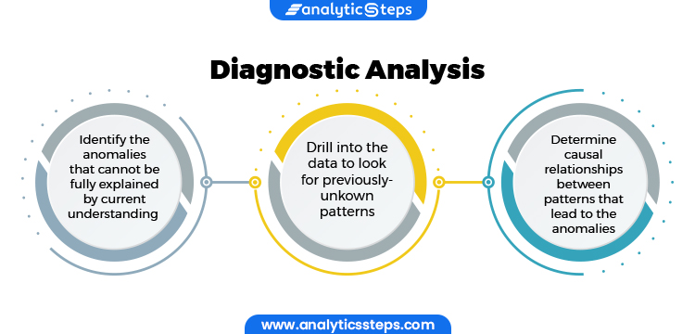

Slide 20
Advantages of diagnostic analytics
By drilling down into data, you can obtain more granular insights than via descriptive analytics alone.
Diagnostic analytics lets you form (and test) hypotheses using hard evidence about what happened in the past.
By comparing input and output data, you can determine whether data points are merely correlated or if they represent a clear cause and effect.
By identifying outliers and anomalies, you can determine whether they represent significant findings or merely erroneous data.
Understanding what triggered past events means that you can avoid repeating costly mistakes—or, conversely, repeat actions that led to unexpectedly positive outcomes.

Slide 21
Disadvantages of diagnostic analytics
The main drawback of diagnostic analytics is that it relies purely on past data.
Necessary limits on its ability to draw conclusions about possible future events.
A need to supplement your analysis with additional sources, including real-time data and third-party historical data.
It requires more time and higher-level skills than descriptive analytics (although, as mentioned in the previous section, new platforms are emerging to mitigate this issue).
It’s easy to mistake correlation for causation, which can have costly impacts.
Notes:
The main drawback of diagnostic analytics is that it relies purely on past data. This has several knock-on effects, including:

Slide 22
Read Yourself Slide
Marketplace analysis
The most common use of diagnostic analytics is marketplace analytics. While descriptive analytics can summarize metrics like a company’s profit, sales, and other industry data, diagnostic analytics helps compare and correlate these data to identify market trends.
Companies might determine, for example, which past products have been most financially successful. By looking at things like when the product launched, which demographic it targeted, and how much it cost, companies can gain invaluable insights into why previous products succeeded and how they might replicate this success.

Slide 23
Read Yourself Slide
Financial fraud and insurance
Diagnostic analytics is vital to detecting financial fraud. For example, if a credit card company detects an unexpected overseas transaction, diagnostic analytics can spot this outlier behavior, alerting the credit card provider to the issue. The user’s card will often be blocked or suspended until the provider can determine whether or not the transaction was fraudulent.
Similarly, insurance providers can uncover common factors in burglaries by analyzing theft claims. For instance, a surge of break-ins may occur in a particular location. Other common factors could be unlocked windows and doors. Identifying at-risk customers allows insurance providers to alert these homeowners; nudging them to be more vigilant, possibly leaving lights on when they leave the house, locking doors, and so on. This can reduce break-ins and costly insurance payouts.

Slide 24
Read Yourself Slide
Healthcare analytics
Within healthcare, diagnostic analytics finds a very literal application—disease diagnosis. Doctors are highly trained, but also very busy. Diagnostic algorithms can correlate symptoms (such as a rash, sore throat, inflammation) against known diseases. This can provide doctors with possible illnesses to narrow down their work.
While the outcome of these diagnostic algorithms may not be 100% accurate, that’s not the point. Instead, diagnostic tools allow doctors—who are better at detecting the nuances of disease than algorithms—to focus on a smaller handful of possible diagnoses. This makes it easier for them to diagnose the correct illness. The result is a more efficient clinical process, freeing doctors to diagnose other patients while ensuring that existing ones receive the care they need.

Slide 25
Summary
Diagnostic analytics involves drilling down into historical data to identify why something has happened.
Diagnostic analytics is excellent for exploring anomalies and outliers and identifying correlation, cause, and effect.
Diagnostic analytics employs various techniques from probability theory to regression, clustering, and time-series analysis, to name a few.
The main advantage of diagnostic analytics is that it provides more granular insights than descriptive analytics (which merely summarizes data).
One disadvantage of diagnostic analytics is that it’s possible to mistake correlation for causation, skewing your insights.
Diagnostic analytics has many uses in fields like finance and insurance, healthcare, and market research.

Slide 26
Predictive Analytics
Predictive analytics is a branch of advanced analytics that makes predictions about future outcomes using historical data combined with statistical modeling, data mining techniques and machine learning.
Companies employ predictive analytics to find patterns in this data to identify risks and opportunities.
Notes:
https://www.ibm.com/in-en/analytics/predictive-analytics#:~:text=Predictive%20analytics%20is%20a%20branch,to%20identify%20risks%20and%20opportunities.

Slide 27
Benefits
ScalabilityAutomate data science and data engineering tasks. Train, test and deploy models seamlessly across multiple enterprise applications. Extend common data science capabilities across hybrid, multicloud environments.
SpeedHarness pre-built applications and pre-trained models. Help data science and business teams collaborate and streamline model building with state-of-the-art IBM and open source software.
SimplicityUse a central platform to manage the entire data science lifecycle. Standardize development and deployment processes. Create a single framework for data governance and security across the organization.

Slide 28
Good predictions rely on good data. Incomplete or inaccurate data will not result in good projections.
Good future outcomes depend upon choosing the best predictive modeling techniques when looking for patterns in data sets. Data scientists are trained in this, and new automated machine learning systems can run models to find the best approaches.
Ambiguity is inevitable in predictions -- case in point: weather forecasts. Learn to work with imperfect results.
Your predictions should be actionable insights. You should be able to do something useful with the prediction and test its accuracy in the future.

Slide 29
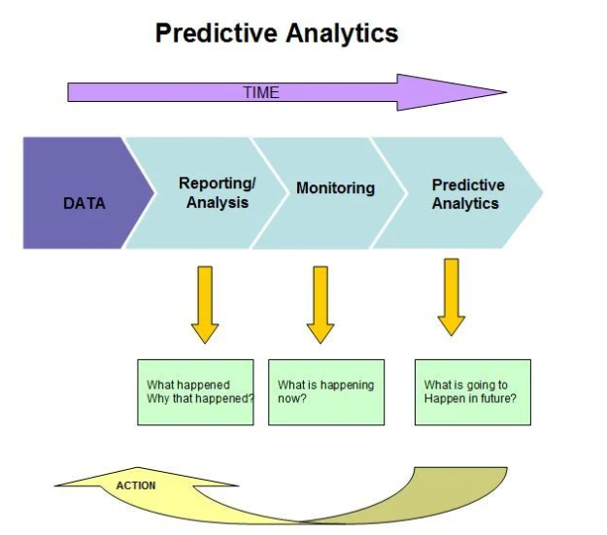

Slide 30
predictive analytics working
Multiple variables are combined into a predictive model capable of assessing future probabilities with an acceptable level of reliability.
logistic regression models,
time series analysis and
decision trees

Slide 31
How to develop a predictive analytics process
Define the requirements. Understand the business problem you're trying to solve. Is it managing inventory? Reducing fraud? Predicting sales? Generating questions about the problem and listing them in order of importance is a good start. Collaborating with a statistician at this stage can help form metrics for measuring success. A business user or subject matter expert generally takes charge of this first step.
Explore the data. Here, you'll want to loop in a statistician or data analyst or both. The job is to identify the data that informs the problem you're trying to solve and the goal. Consider the relevancy, suitability, quality and cleanliness of the data.

Slide 32
How to develop a predictive analytics process
Develop the model. A data scientist can help figure out which predictive models are best suited to solving the problem. It's important to experiment with different features, algorithms and processes in order to strike a balance between performance, accuracy and other requirements, such as explainability.
Deploy the model. Once the model is approved by the data scientist, a data engineer determines how best to retrieve, clean and transform the required raw data to deploy the model at scale and, above all, in a way that makes a meaningful difference -- e.g., integrating a new scoring algorithm into the sales team's workflow.
Validate the results. Performance of the model can change over time due to shifts in customer preferences or the business climate, or unforeseen events such as a pandemic. Thresholds for updating models vary, requiring the joint expertise of a business user and a data scientist in this step.

Slide 33
Predictive Analytics Use Cases
BankingFinancial services use machine learning and quantitative tools to predict credit risk and detect fraud.
HealthcarePredictive analytics in health care is used to detect and manage the care of chronically ill patients.
Human resources (HR)HR teams use predictive analytics to identify and hire employees, determine labor markets and predict an employee’s performance level.

Slide 34
Marketing and salesPredictive analytics can be used for marketing campaigns throughout the customer lifecycle and in cross-sell strategies.
RetailRetailers use predictive analytics to identify product recommendations, forecast sales, analyze markets and manage seasonal inventory.
Supply chainBusinesses use predictive analytics to make inventory management more efficient, helping to meet demand while minimizing stock.

Slide 35
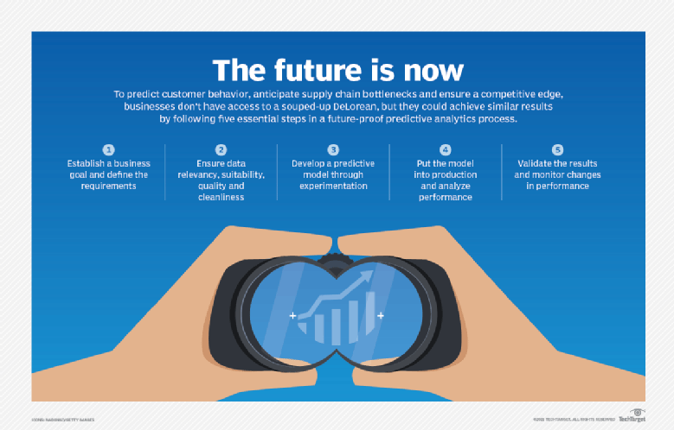
Notes:
https://www.techtarget.com/searchbusinessanalytics/definition/predictive-analytics

Slide 36
What is predictive analytics used for?
Weather forecasting is one of the best-known uses of predictive modeling.
Predictive analytics is also used to forecast elections, predict the spread of diseases and model the effects of climate change.
Notes:
In business, predictive modeling helps companies optimize operations, improve customer satisfaction, manage budgets, identify new markets, anticipate the impact of external events, develop new products and set business, marketing and pricing strategies. For example, an insurance company is likely to take into account potential driving safety variables -- such as age, gender, location, type of vehicle and driving record -- when pricing and approving auto insurance policies.
Business applications for predictive analytics include targeting online advertisements, analyzing customer behavior to determine buying patterns, flagging potentially fraudulent financial transactions, identifying patients at risk of developing particular medical conditions and detecting impending parts failures in industrial equipment before they occur. Wall Street uses predictive modeling to pick stocks and other investments.
As observed, the marketing industry has been a notable adopter of predictive analytics, along with large search engine and online services providers. Other industries that are big users of predictive analytics include healthcare and manufacturing. Specific examples of how companies use predictive analytics are detailed later in this guide.

Slide 37
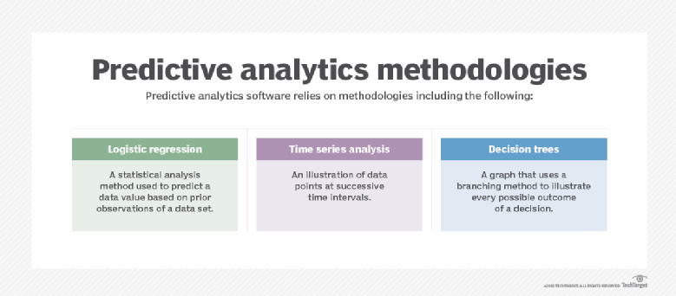

Slide 38
Predictive analytics techniques
data mining to sort through large data sets for patterns and relationships that can help solve business problems through data analysis;
text analytics to mine text-based content, such as Microsoft Word documents, email and social media posts;
machine learning, including the use of classification, clustering and regression algorithms that help identify data patterns and relationships; and
more advanced deep learning based on neural networks, which emulate the human brain and can further automate predictive analytics efforts.

Slide 39
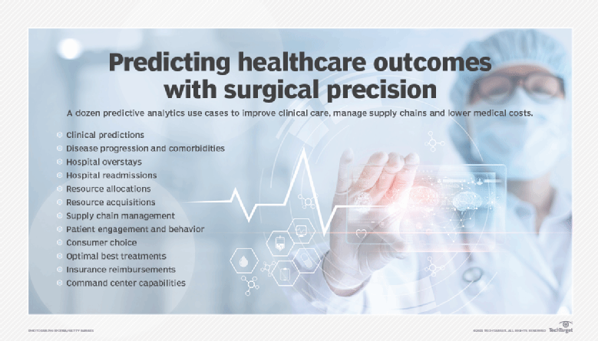

Slide 40
Predictive analytics tools
AWS, Google, IBM, Microsoft, SAP, SAS Institute and many other software vendors offer predictive analytics tools and related technologies supporting machine learning and deep learning applications.
The open source R analytics language is commonly used in predictive analytics applications, as are the Python and Scala programming languages.

Slide 41
What is the future of predictive analytics?
Traditionally the domain of data scientists and other quantitative experts, predictive analytics has been an art and science practiced by the highly trained few for -- when it works -- the benefit of the many.
But the field of advanced analytics is changing. As noted in Lawton's article on predictive analytics tools and techniques cited above, vendors are finding ways to reduce the time and expertise involved in building predictive models. "What used to require weeks of writing code can now be accomplished with a few mouse clicks and a lot of automation on the back end," Lawton reported.
Advanced machine learning techniques are reducing the need to deeply understand how different variables affect each other, automatically choosing the best combination of algorithms for a given task. There is also a growing market of industry-specific analytics tools with prebuilt models and templates that embody best practices and dramatically simplify the predictive analytics process. Predictive analytics is becoming democratized, to use the industry parlance -- or that is the promise, at least.
Forrester Research principal analyst Boris Evelson, a leading expert on analytics who has covered this field for decades, has made these advanced analytics tools a chief area of his research focus. The embedded ML algorithms and conversational user interfaces, with natural language processing and natural language generation features, are potentially a game changer, he said. "So, not only do I no longer need a data scientist to make that calculation. I don't need a data scientist to explain it to me."
But it is early days, and these potentially wondrous tools are up against a persistent barrier. Two decades ago, Evelson said, new developments in BI software were heralded as "the greatest thing since sliced bread," offering point-and-click, drag-and-drop interfaces that put this then-advanced technology within reach of the user masses. That didn't happen.
"The number we like to use today is about 20% -- that is, no more than 20% of all enterprise decision-makers who could be using and should be using these tools are using them today," he said. "The rest are still relying on professional data analysts."
Technology is partly to blame, but it's mostly people, culture, process and data challenges that get in the way of wider adoption. With these new augmented analytics platforms, Evelson said, "is that 20% now going to be 30%, 40%, 50%? I don't know."
It's not just early, he added, but the benefits these automated intelligence platforms bring also carry risks. The machine learning algorithms and models are only as good as the data they're trained on. "If that data changes very rapidly, and it changes in a pattern that no longer looks like the data it was trained on -- well, professional data scientists understand this and work it into the process," Evelson said. But ModelOps "hasn't really made its way into these new augmented BI platforms yet." Updating these models can be a full-time job for a lot of people, he noted, suggesting that for now, at least, predictive analytics and other forms of advanced analytics is still a professional's game.

Slide 42
Prescriptive analytics
Prescriptive analytics has been called “the future of data analytics,” and for good reason.
This type of analysis goes beyond explanations and predictions to recommend the best course of action moving forward.
It’s especially useful in driving data-informed decision-making.
Notes:
https://online.hbs.edu/blog/post/prescriptive-analytics
https://www.ibm.com/in-en/analytics/prescriptive-analytics

Slide 43
Benefits: IBM
Improve operationsOptimize product planning, reduce inefficiencies and drive smarter operational decision-making.
Increase efficiencyBetter utilize capital, personnel, equipment, vehicles and facilities.
Mitigate risksGain insight into how decisions can have business-wide impacts and hedge against data uncertainty.

Slide 44
Case Study 1 by IBM
https://www.ibm.com/case-studies/leading-bulk-tanker-transportation-company-hybridcloud

Slide 45
Case Study 2 by IBM
https://www.ibm.com/case-studies/bondit

Slide 46
Case Study 3 by IBM
https://www.ibm.com/case-studies/cimsa-cplex-gbs

Slide 47
PRESCRIPTIVE ANALYTICS IN ACTION
1. Venture Capital: Investment Decisions
Investment decisions, while often based on gut feelings, can be strengthened by algorithms that weigh risks and recommend whether to invest.
One example in the venture capital space is an experiment—explained in the Harvard Business Review—that tested the effectiveness of an algorithm’s decisions about which startups to invest in as compared to angel investors' decisions.
The findings were nuanced. The algorithm outperformed angel investors who were less experienced at investing and less skilled at controlling their cognitive biases; however, angel investors outperformed the algorithm when they were experienced in investing and able to control their cognitive biases.
This experiment sheds light on the complementary role prescriptive analytics must play in making decisions and its potential to aid decision-making when experience isn’t present and cognitive biases need flagging. An algorithm is only as unbiased as the data it’s trained with, so human judgment is required whether using an algorithm or not.

Slide 48
2. Sales: Lead Scoring
Prescriptive analytics plays a prominent role in sales through lead scoring, also called lead ranking. Lead scoring is the process of assigning a point value to various actions along the sales funnel, enabling you, or an algorithm, to rank leads based on how likely they are to convert into customers.
Actions you can assign value to include:
Page views
Email interactions
Site searches
Content engagement, such as attending webinars, downloading e-books, or watching videos
When assigning each action a point value, assign the highest number of points to those that imply purchase intent (for instance, visiting a product page) and negative points to those that reveal non-purchase intent (for instance, viewing job postings on your site). This can help prioritize outreach to leads most likely to convert into customers, potentially saving your organization time and money.

Slide 49
3. Content Curation: Algorithmic Recommendations
If you’ve ever scrolled through a social media platform or dating app, you’ve likely experienced prescriptive analytics firsthand through algorithmic content recommendations.
Businesses’ algorithms gather data based on your engagement history on their platforms (and potentially others, too). The combinations of your previous behaviors can act as triggers for an algorithm to release a specific recommendation. For instance, if you regularly watch shoe review videos on YouTube, the platform’s algorithm will likely analyze that data and recommend you watch more of the same type of video or similar content you may find interesting.
On social media, TikTok’s “For You” feed is one example of prescriptive analytics in action. The company’s website explains that a user’s interactions on the app, much like lead scoring in sales, are weighted based on indication of interest.
“For example,” TikTok’s website says, “if you finish a video, that’s a strong indicator that you’re interested. Videos are then ranked to determine how likely you’ll be interested in each video and delivered to each unique ‘For You’ feed.”
This prescriptive analytics use case can make for higher customer engagement rates, increased customer satisfaction, and the potential to retarget customers with ads based on their behavioral history.

Slide 50
4. Banking: Fraud Detection
Another algorithmic use of prescriptive analytics is the detection and flagging of bank fraud. With the sheer volume of data stored in a bank’s system, it would be nearly impossible for a person to manually detect any suspicious activity in a single account. An algorithm—trained using customers’ historical transaction data—analyzes and scans new transactional data for anomalies. For instance, perhaps you typically spend $3,000 per month, but this month, there’s a $30,000 charge on your credit card.
The algorithm analyzes patterns in your transactional data, alerts the bank, and provides a recommended course of action. In this example, the course of action may be to cancel the credit card, as it could have been stolen.

Slide 51
5. Product Management: Development and Improvement
Prescriptive analytics can also inform product development and improvements. Product managers can gather user data by surveying customers, running tests with a product’s beta versions, conducting market research with people who aren’t current product users, and collecting behavioral data as current users interact. All this data can be analyzed—either manually or algorithmically—to identify trends, discover the reasons for those trends, and predict whether the trends are predicted to recur.
Prescriptive analytics can help determine which features to include or leave out of a product and what needs to change to ensure an optimal user experience.

Slide 52
6. Marketing: Email Automation
Email automation is a clear-cut example of prescriptive analytics at work. Marketers use email automation to sort leads into categories based on their motivations, mindsets, and intentions and deliver email content to them based on those categories. Any interactions leads have with emails can put them in another category, resulting in a different set of messages being triggered.
While this is pure algorithmic prescriptive analysis, a person should plan, create, and oversee automation flows. Email automation allows companies to provide personalized messaging at scale and increase the chance of converting a lead into a customer using content that applies to their motivations and needs.

Slide 53
How Do Prescriptive Analytics Work?
To process such a huge amount of data stacks, the analytics uses concepts of Artificial intelligence technology, machine learning computing tactics, and in most scenarios use any type of human input.
Due to the scalability and reliability of technological era machines which quickly self-learn and adapt themselves of holding extra data packages and deriving well-advanced solutions as per the convenience remains advantageous.
It goes beyond simple prediction options and delivers a range of potential ideas for each action. The process can be stated as much faster and even more accurate than human capacity.

Slide 54
What are the Benefits of Prescriptive Analytics?
Revenue Generation
Prescriptive analytics can help a business understand what their customers want to buy and why. These outcomes can be arrived at with detailed and timely information on customers and their purchasing journeys. This will help managers accelerate their sales cycles and be able to find and open up new avenues for cross and up-selling.
Gross Margin Management
The prescriptive analytics models provide insights into the optimal mix of products that an organization should focus its attention on. The model for this can be created based on current as well as anticipated market conditions and customer purchase patterns. It will ensure higher business productivity and profitability.
Expense Reduction
With the right algorithmic model, a company will be able to ensure that they have better inventory management systems in place. This will help in reduction of costs for long term stock storage. It also brings down the number of manual processes and costs involved. An organization will also have better control over their expenses and transparency across the board.

Slide 55
Uses for Prescriptive Analytics
The uses of prescriptive analytics are still in the nascent stages, but it has managed to impact quite a few key industries. Below are several use cases that one can learn from.
Optimizing the Travel and Transportation Sector
In the travel industry, a lot depends on pricing and sales for travel and transportation. Considering the large amounts of data that are available, prescriptive analytics as an approach works ideally for the sector. Everything from online travel and hotel websites to ticket buying services, hotel bookings and more can make use of prescriptive analytics and determine their pricing and sales pitches based on customer perspectives, their choices, route optimization, as well as a categorization of the different kinds of travelers and their needs. All this can be derived from data sets that the sector already has in their database. This has encouraged a good degree of competition and helped travel businesses stay on top of their game.
Fracking and Oil Production
Fracking for oil production has been on the rise in recent years, catering to demand. Knowing where to frack, how to make the process a safer one and optimizing it for best use has been done with the help of prescriptive analytics and this has led to the substantial growth of the use of the process.

Slide 56
Healthcare Industry
This is perhaps the largest sector to have employed prescriptive analytics to its benefit. The healthcare sector in general has employed a wide range of technologies to make itself more efficient.
It works hand in hand with predictive analytics in the case of healthcare. Predictive analytics help with the identification of specific patient populations and disease categories that may affect them. This can be further micro-classified on a range of parameters. With prescriptive analytics, one can determine the best action plan and even measure the efficacy of interventions.
With the advances in technology and the speed at which the medical sector employs it, there are several opportunities for effective collection and analyses of a wide range of data. All of this helps create actionable insight.
Prescriptive analytics also work well in assessing quality risk in the medical sector, especially in identifying a variation in practice. It will be able to determine, for example, the best practices for specific kinds of interventions - a knee replacement surgery versus a repair procedure.
Prescriptive analytics makes use of patient and clinical data to help enhance performance and promote wellness and the management of diseases in a more effective manner.

Slide 57
Challenges with Prescriptive Analytics
Difficult to Define a Fitness Function
To optimize results, every prescriptive analytical model requires a fitness function (how ‘fit’ the solution is for the problem) to be well defined. A fitness function forms the base to help obtain the ideal set of solutions. However, arriving at this function can be difficult because it requires an in-depth understanding of the business from multiple angles. The best approach to handling this is to involve business partners early on to ensure that the algorithms you create are accurate to business outcomes.
Human bias in models
Unfortunately, one of the biggest inhibitors to the growth of prescriptive analytics is that most models are human written meaning they have an inherent bias. In fact, most discussions on prescriptive analytics talk about this unfortunate fact. What this means is that the algorithms are set up in a certain way, not based on data but based on a domain expert’s opinions. One of the future fixes for this would be to generate models using machine learning based on the data that is flowing in. That would be an ideal way to cross out any potential human bias.
Complex Constraints
Parameters need to be in place to be able to build a prescriptive analytical model that functions towards finding a range of solutions. Often there are constraints on these parameters. This happens when the solution it arrives at cannot be achieved. This could happen because of a negative length or because of a business rule that doesn’t allow a price change beyond a certain amount. There are two ways to handle this – make sure the optimizer knows of these rules or have them coded into the fitness function.
Notes:
Prescriptive analytics, although very underutilized today, can improve decision making by helping analysts get closer to tying outcomes to specific situations. However, capturing business value from data requires insight into real-time events to capture the value when it matters. Plus, it's not just knowing the future but to take intelligent actions quickly you need to know exactly what to do and when to do it. Prescriptive analytics fills this critical need for businesses.
The future of prescriptive analytics will rely on event processing technology as well as distributed, pervasive computing infrastructure along with machine learning algorithms to facilitate actionability. Distributed processing and data management in conjunction with advanced algorithms, should enable prescriptive analytics solutions to identify risks and potential problems in business situations, but also recommend mitigating actions. All of these enabling technologies will enable next generation prescriptive analytics to deliver real-time decision support to business users. Prescriptive analytics are a great tool if utilized well. It is still the least used type of analytics but the potential for organizations is immense.

Slide 58
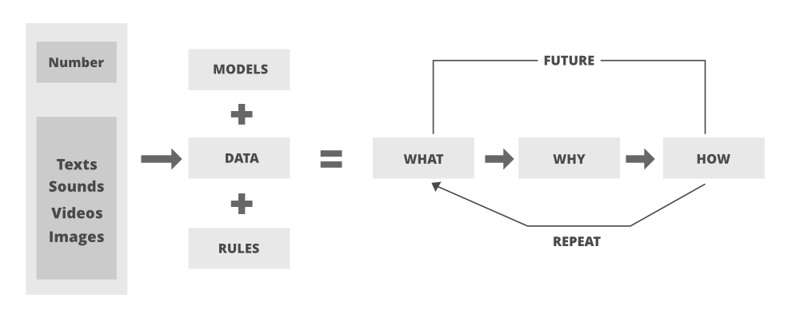

Slide 59
Thank you

